Slide 1
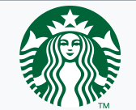
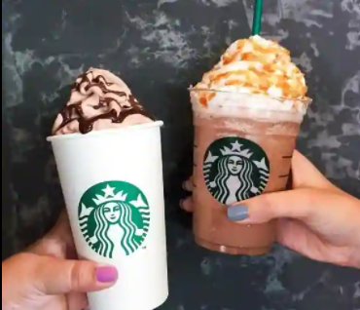
Case study- 7p’s of Starbucks - Archana Gurung

Slide 2
INTRODUCTION
Starbucks Corporation is one of the largest food and beveragesmultinational enterprises (MNEs), its industry included restaurants, retail coffeeand tea, beverages, entertainment and etc. Starbucks operate in over 50countries and it has more than 17,000 stores in the world (Starbucks CompanyProfile, 2011). Starbucks starts its first store in Seattle’s Pike Place Market, at1971 (Starbucks Company Profile, 2011). After 25 years, Starbucks opens thefirst store outside of North America in Japan. At present, Starbucks is the largestcoffeehouse in the world. In this competitive era, business corporations tend to be globalised inorder to maintain their competitive strength. However, every market has their ownculture and policy which has become barriers for the multinational enterprises(MNEs) when they are entering overseas markets. Therefore, Company mustcarry out a specific marketing strategic for each different market in order tosuccessfully penetrate into a market.The reasons why Starbucks is chosen for investigation in this assignmentis because Starbucks have been successfully operation at overseas and it canbe sustainable corporations in the worlds, as Starbucks got an award andrecognition of “Global 100 Most Sustainable Corporations in the World” at 2010(Starbucks Company Recognition, 2011), however, Starbucks also got the “No 1Best coffee” award and recognition at 2009 (Starbucks Company Recognition,2011).

Slide 3
STARBUCKS IN INDIA – TATA STARBUCKS
HISTORY
Tata Starbucks Private Limited, formerly known
as Tata Starbucks Limited,^{[5]} is a 50:50 joint venture
company, owned by Tata Consumer Products and Starbucks Corporation,^{[6]}
that owns and operates Starbucks outlets in India.^{[7]} The outlets are branded
Starbucks "A Tata Alliance".

Slide 4
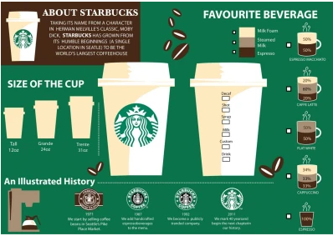

Slide 5
PRODUCT
Q1: What is the core product of Starbucks?
A1: Starbucks Experience
Q2: What are the actual and augmented products of Starbucks?
A2: In terms of the augmented product, Starbucks offers after-sales service in the form of wireless connections and atmosphere in store, as well as providing customers with some education about coffee and coffee making and an interactive website.
Q3: What are the various product categories offered by Starbucks?
A3: Coffee cup sizes , Low calorie and sugar-free products , Non-dairy milk offerings , Ethos water ,Instant coffee and coffee capsules , Coffee makers and single-use capsules ,Alcoholic drinks
Q4: How has Starbucks adapted its product offering to suit the Indian market?
A4: The Indian market is quite different as the coffee consumption in India is very low - with consumption of only 82 grams per capita as compared to 4 kilograms per capita in the USA. Research in India has indicated that most people go to a café to socialize and form stronger personal and business relationships, and not merely for drinking coffee. Realizing this trend, Starbucks has customized its store ambience along with customization of its product offerings. To penetrate the price sensitive Indian market, the products are also priced lower as compared to the prices in the USA, but the prices have been kept relatively high as compared to major competitors like Café Coffee Day and Barista Lavazza. Starbucks have introduced Tata's branded tea called Teavana and Himalayan water beverages to add to the products .

Slide 6
Q5: How has Starbucks introduced healthy products in its range?
A5: Yet another addition to their healthy options is the Savoury Quinoa Oatmeal which is served along with bell peppers and roasted walnuts. The power packed meal of oats and quinoa can make for a healthy meal. We also enjoyed their other news eats – Chicken Pita and Vanilla Cruffin.
Q6: Mention an innovation by Starbucks with regard to an existing product?
A6: In January, Starbucks unveiled its first new beverages for 2020, and plant-based milk alternatives starred in all three: the Almondmilk Honey Flat White, Coconutmilk Latte and Oatmilk Honey Latte.
Q7: What are some partnerships that Starbucks has entered, from the point of view of product?
A7:Tata Starbucks launched the Starbucks Delivers program in early 2019. The service offers home delivery from Starbucks outlets through a partnership with Swiggy. The service was first launched in Mumbai, with plans to roll it out to other cities.

Slide 7
PRICE
Q1: What is the most expensive coffee that Starbucks in CP sells?
A1: Venti Caramel Praline Latte @ Rs 365
Q2: What is the least expensive coffee that Starbucks in CP sells?
A2: Brewed Coffee @ Rs 185
Q3: Which of the following pricing strategies does Starbucks follow? Justify your answer.
Economy pricing strategy
Penetration pricing strategy
Skimming pricing strategy
Premium pricing strategy
A3: Premium pricing strategy - For the most part, Starbucks is a master of employing value based pricing to maximize profits, and they use research and customer analysis to formulate targeted price increases that capture the greatest amount consumers are willing to pay without driving them off.

Slide 8
PROMOTION
Q1: What is the primary means of promotion for Starbucks?
A1: Starbucks uses a large variety of channels to market their product from social media to TV spots and ads. It's their mix of marketing media that makes their brand recognizable, and it's the consistent message that comes across every time that makes them stand out. All of that promotion isn't cheap.
Q2: How does Starbucks go about executing its primary means of promotion?
A2: The Starbucks has adopted a brand differentiation strategy through product uniqueness and product differentiation in order to promote its products. Starbucks has used innovation in its products and services in order to gain competitive advantage in the market.
Q3: What is meant by ‘Third Place’ in the context of the marketing strategy of Starbucks?
A3: Starbucks’s Mission and Values come to life in the promotion of equitable, diverse and inclusive cultures: in our workplace, our communities, and in our stores, a third place environment where everyone is welcome and we can gather, as a community, to share great coffee and deepen human connection.
Q4: What is meant by ‘Fourth Place” in the context of the marketing strategy of Starbucks?
A4: The ‘Fourth Place’: Starbucks as a technology giant - Starbucks is becoming more of a technology company is in its stores, through the Starbucks Digital Network, enabled by the free wifi that the company rolled out earlier this year.

Slide 9
PLACE
Q1 :How many cities in India have at least one Starbucks store?
A1: As of April 2021, Starbucks operates 219 outlets in 24 cities of India.
Q2: What is the total number of Starbucks stores in India?
A2: 216 Stores (December 2020)
Q3: Which cities in India tend to have a Starbucks store? Why?
A3: Tata Starbucks plans to expand its footprint to two new cities by the year end, taking the total count to 10, a top company official said. The company, a 50:50 joint venture between Tata Global Beverages
and Starbucks Coffee of the US, believes that the Indian market has "tremendous opportunity" for growth as coffee consumption level is lower than the West.

Slide 10
Q4: Mention an innovation by Starbucks with regard to its store strategy.
A4: Store design, or brand localization, is just one of the creative ways Starbucks connects with its customers, integrating local aesthetics into each of its stores. The company’s design studios are strategically located so that designers can better understand their communities. In Times Square, you may discover a theatrical feel inside each store; in the South, designers might pull inspiration from a weathered barn or blues music; and at a store near the beach, colors borrowed from lapping ocean waves may be the latest inspiration.
Q5: What are some partnerships that Starbucks has entered, from the point of view of the place?
A5: There has been a sourcing agreement in place between Starbucks and Tata Coffee (also part of the group) for over a year. Starbucks will now be working with other group firms such as Taj Catering and the Taj hotel chain.

Slide 11
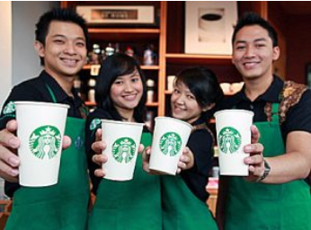
PEOPLE
Q1: What are the primary target customer segments for Starbucks?
A1: The target audience of Starbucks is middle to upper-class men and women. It's the percentage of the general public who can afford their higher priced cups of coffee on a regular or daily basis. And this is who their marketing is targeted to reach. Starbucks' marketing focuses on creating the perfect “third place”.
Q2: What is the connection between the target customer segments for Starbucks and its choice of price and place?
A2: According to a research report done in April 2017, the target audience for Starbucks is men and women in the middle to upper classes who can afford Starbucks higher priced beverages regularly.
They offer their target audience an experience when they come into their stores.
By focusing on the third place and giving their customers a place to be and interact, they make the price of the drink worth it in the eyes of their customers.
There is something comforting about ordering a good cup of coffee and being encouraged to sit in the shop with your laptop and work. That’s the experience Starbucks provides.

Slide 12
Q3: What are Starbucks employees called?
A3: Starbucks employees Partners
Q4: Mention an innovation by Starbucks with regard to its employee training ?
A4: New employees get their initial training from their store manager, as well as dedicated trainers responsible for teaching the Starbucks Experience classes which cover the company history, its legacy of social responsibility, and its culture. The Starbucks Experience is typically taught to groups of new hires at regional training centers, or in-store in more remote markets. Each store also has a learning coach — another partner who has shown a passion for training and teaching — who guides new hires through the Barista Basics hands-on training program.

Slide 13
PHYSICAL EVIDENCE
Q1: How does the Starbucks store layout contribute to its marketing strategy?
A1: Starbucks focuses on promoting unique and fan-favorite beverages. The brand knows how popular their flagship items are, but more importantly, they know their audience craves this kind of content.
Q2: What is the Starbucks logo?
A2: The iconic twin-tailed siren on Starbucks' logo serves as a reference to Seattle and the sea. Wanting to communicate Seattle's close proximity to the sea, the siren is seen to have hair that looks similar to ocean waves.
Q3: Has the Starbucks logo evolved over time?
A3: Starbucks' logo has gone through two previous shifts, most dramatically in 1987, when Starbucks turned a brown woodcut into a green and black image. It dropped "tea" and "spices" from the text and changed the siren from a 16th-century Norse woodcut to a more stylized black-and-white graphic.

Slide 14
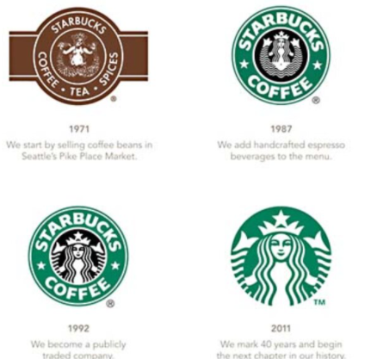
Q3: Has the Starbucks logo evolved over time?
A3: Starbucks' logo has gone through two previous shifts, most dramatically in 1987, when Starbucks turned a brown woodcut into a green and black image. It dropped "tea" and "spices" from the text and changed the siren from a 16th-century Norse woodcut to a more stylized black-and-white graphic.
Q4: Can the Starbucks app be considered part of physical evidence in the 7 Ps framework? Justify your answer.
A4: Yes, Starbucks aims to address the 7Ps of Starbuck which stand for product, price, place, promotion, process, people, and physical evidence. Starbucks is the biggest coffee house chain in the worldwide in terms of number of stores. It is an American coffeehouse chain which was founded in Seattle in 1971. It operates in 80 countries and has over 32,646 stores . Starbucks has developed a number of apps (Starbucks App for iPhone, Starbucks App for Android, and Starbucks App for Windows) for busy customers who would like to walk in select stores and go straight to their coffee! It is also partnered with Uber Eats and Just Eat to deliver coffee, snacks, food items, and other beverage in many U.S. cities, the UK, and beyond.

Slide 15
PROCESS
Q1: What is the process improvement philosophy that Starbucks adopted a decade ago to improve its productivity?
A1: Lean Six Sigma implementation ensures Starbuck's success. It was introduced in early 2000
Q2: What are some of the key metrics that Starbucks uses to measure in-store productivity?
A2: Starbucks is using listening metrics and demographic metrics from its white label (company branded) My Starbucks Idea website, Twitter engagement, Facebook page, Gold Card rewards program, and more to fine-tune what it's offering customers and to growing its reach.

Slide 16
THE END

